Slide 1

Marketing Presentation
Marketing research for ReMade in Cambodia

Slide 2

Research Context
Conducted via online survey
Convience sample
112 Respondents

Slide 3
OB: Identify how American consumers currently perceive Cambodian products, including their views on quality, sustainability, authenticity, and value, to determine whether ReMade is seen as desirable.
Recap of objectives

Slide 4
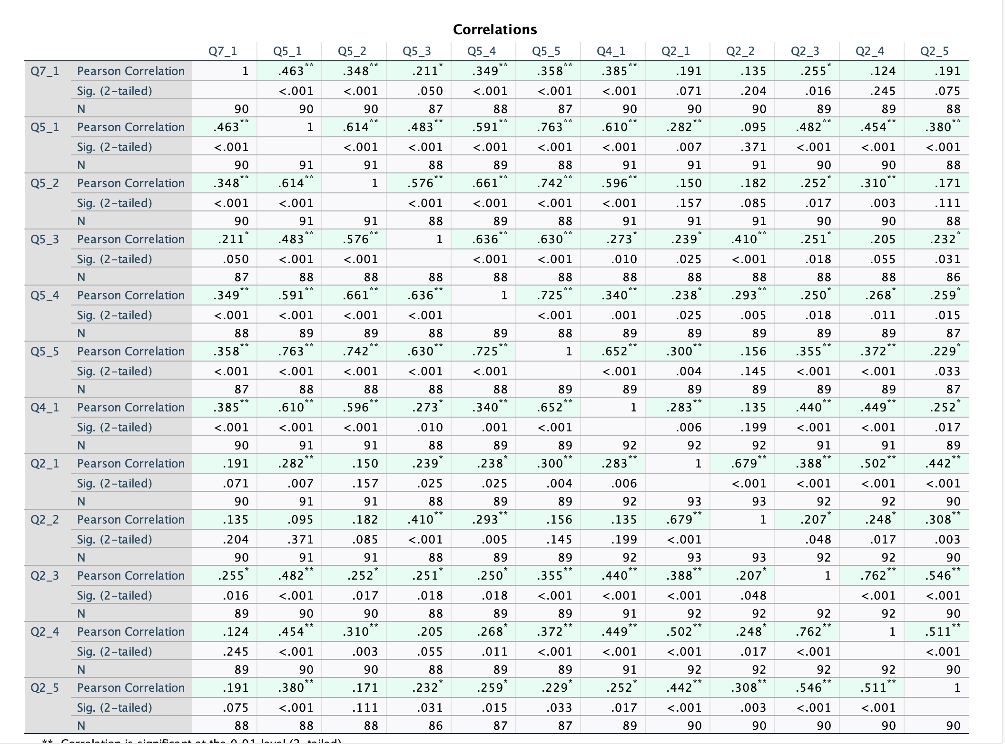

Slide 5
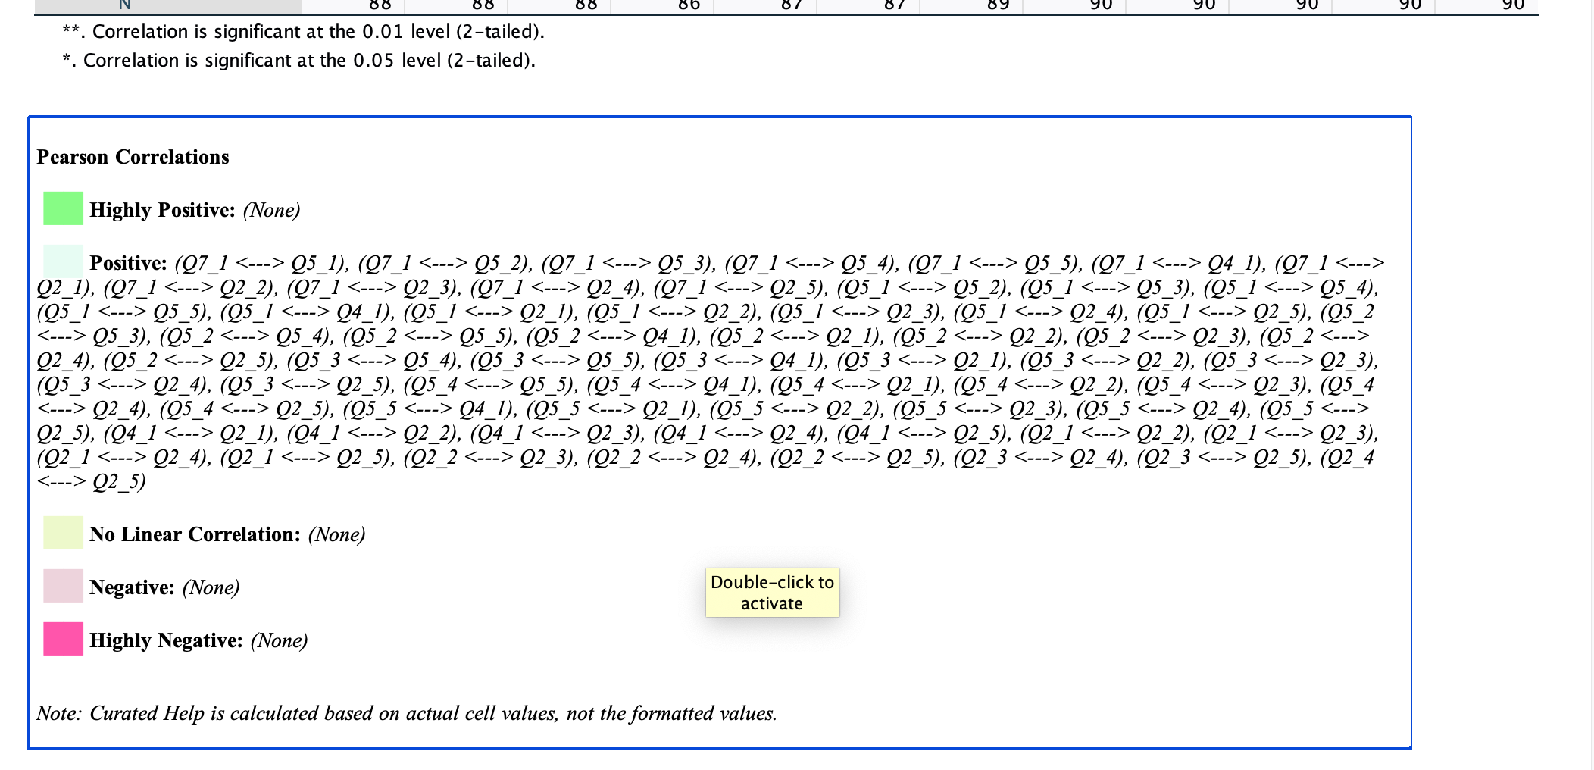

Slide 6
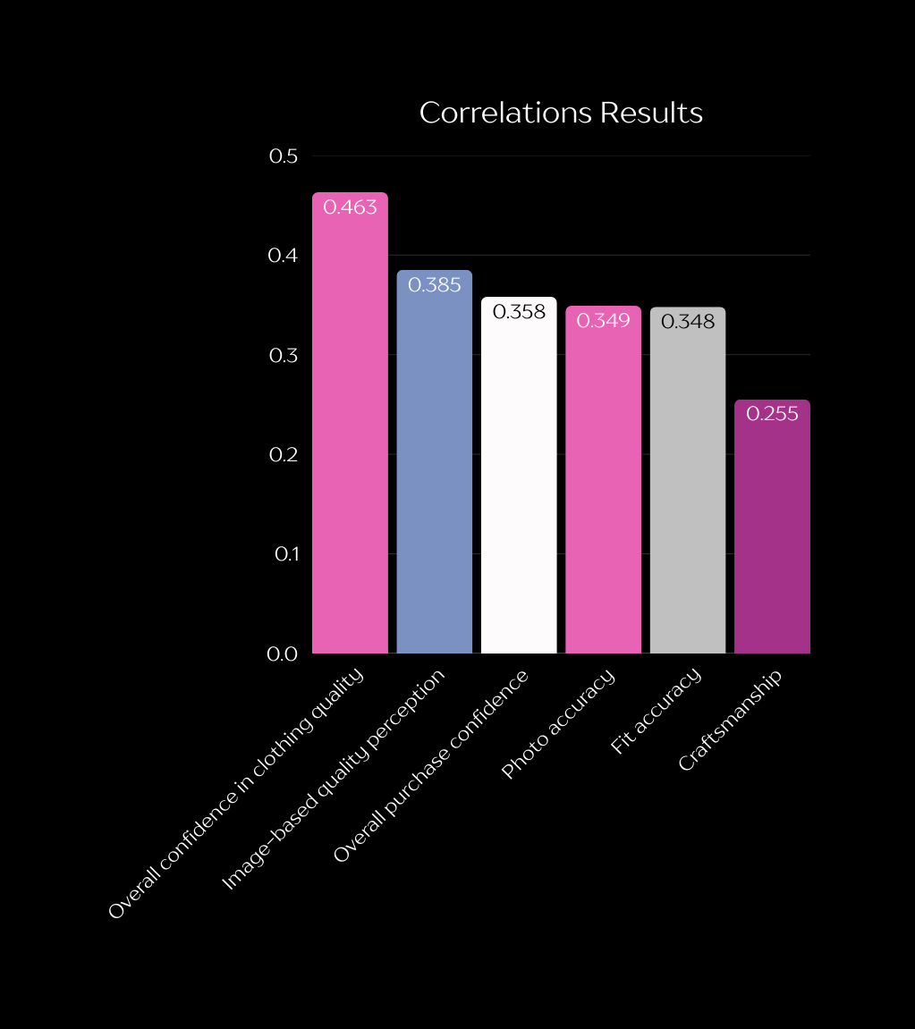
What are participants purchase intention?
Overall confidence in clothing quality regarding a product with a ‘Made in Cambodia’ label had a strong positive correlation with Q7 (purchase intention ) with an r-value of .463 and a p < .05.
Image-based quality perception : how good the clothing looked in the pictures attached to Q4, — had a moderate correlation with purchase intention with an r value of .385, and a p < .05.
Cambodian made products show strong craftsmanship had a slight correlation with purchase intention with an r-value of 0.255 and a p-value <.05.
Notes:
Based on Objective 1, we ran a correlations test to identify which factors most strongly influence purchase intention. Our dependent variable (Q7) measures how likely someone is to choose a Cambodian brand over their favorite brand if the quality were the same, making it the best indicator of purchase intention for our analysis. To understand what perceptions might shape that intention, we selected three independent variables: Q5, which captures consumers’ overall confidence in buying a product labeled ‘Made in Cambodia’; Q4, which measures how the product’s quality is perceived based on the survey images; and Q2, which reflects whether consumers believe Cambodian products demonstrate strong craftsmanship.
Overall confidence in clothing quality regarding a product with a ‘Made in Cambodia’ label had a strong positive correlation with Q7 (purchase intention ) with an r-value of .463 and a p < .05.
Perceived quality based on the photos shown in the survey had a moderate correlation with purchase intention, with an r-value of .385 and a p < .05.
Overall purchase confidence, confidence that the product will match the photos online, and confidence that the clothing would fit all showed moderate correlations with purchase intention with the r- values being 0.358, 0.349, and 0.348 and all the p-values being <0.05.
Cambodian made products show strong craftsmanship had a slight correlation with purchase intention with an r-value of 0.255 and a p-value <0.05.
Based on these findings we recommend Re-Made in Cambodia to focus their marketing strategy on showcasing:
-Quality demonstrated through clear visuals of the stitching, fabric, and other key garment details
-How the garments fit on different sized models
-Short stories of the Cambodian artisans behind the products on social media
-The upcycling and design techniques used to transform discarded textiles into new, creative fashion pieces

Slide 7

What are participants purchase intention?
Based on these findings we recommend ReMade in Cambodia to focus their marketing strategy on showcasing:
Quality demonstrated through clear visuals of the stitching, fabric, and other key garment details
How the garments fit on body types and sizes
Short stories of the Cambodian artisans behind the products on social media
The upcycling and design techniques used to transform discarded textiles into new, creative fashion pieces
Notes:
Based on Objective 1, we ran a correlations test to identify which factors most strongly influence purchase intention. Our dependent variable (Q7) measures how likely someone is to choose a Cambodian brand over their favorite brand if the quality were the same, making it the best indicator of purchase intention for our analysis. To understand what perceptions might shape that intention, we selected three independent variables: Q5, which captures consumers’ overall confidence in buying a product labeled ‘Made in Cambodia’; Q4, which measures how the product’s quality is perceived based on the survey images; and Q2, which reflects whether consumers believe Cambodian products demonstrate strong craftsmanship.
Overall confidence in the clothing quality of a product labeled ‘Made in Cambodia’ had a strong positive correlation with Q7 (purchase intention ) with an r-value of .463 and a p < .05.
Perceived quality based on the photos shown in the survey had a moderate correlation with purchase intention, with an r-value of .385 and a p < .05.
Overall purchase confidence, confidence that the product will match the photos online, and confidence that the clothing will fit each showed moderate correlations with purchase intention with the r- values being 0.358, 0.349, and 0.348 and the p-values all being <0.05.
Cambodian made products show strong craftsmanship had a slight correlation with purchase intention with an r-value of 0.255 and a p-value <0.05.
Based on these findings we recommend Re-Made in Cambodia to focus their marketing strategy on showcasing:
-Quality demonstrated through clear visuals of the stitching, fabric, and other key garment details
-How the garments fit on different sized models
-Short stories of the Cambodian artisans behind the products on social media
-The upcycling and design techniques used to transform discarded textiles into new, creative fashion pieces

